Slide 1
Diffusion Language
Models Ⅰ
Diffusion Seminar (Week8)
Woojin Kim
AIDAS LAB
Seoul National University
wjk9904@snu.ac.kr

Slide 2
Table of contents
1
From Vision to Language
2
The Challenge: Discreteness of Text
3
Two Big Families of DLMs
4
Continuous DLMs
5
Next Session

Slide 3

From Vision to Language

Slide 4
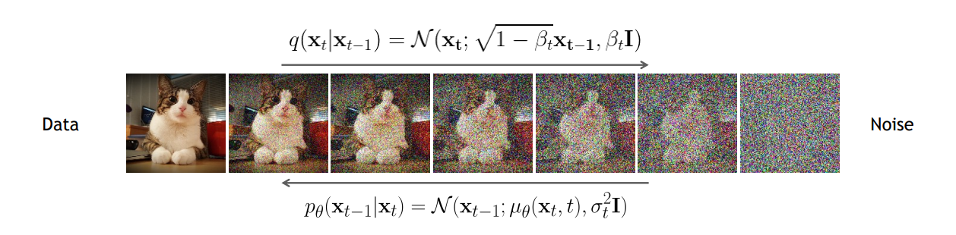
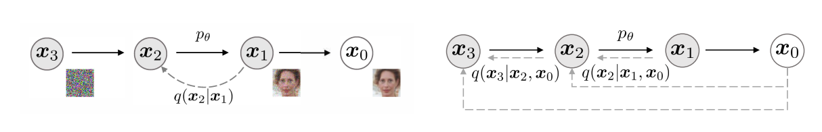
Recap: DDPM, DDIM
1. From Vision to Language
DDPM: Forward process gradually adds Gaussian noise, backward process learns to denoise step-by-step.
DDIM: Deterministic, non-Markovian sampling, fewer steps, better control over trade-off between speed and quality.
https://cvpr2022-tutorial-diffusion-models.github.io/
Song et al., “Denoising Diffusion Implicit Models”, ICLR, 2021

Slide 5
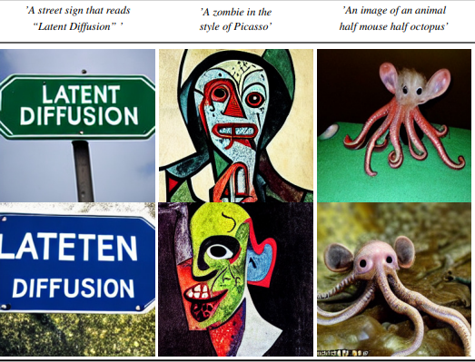
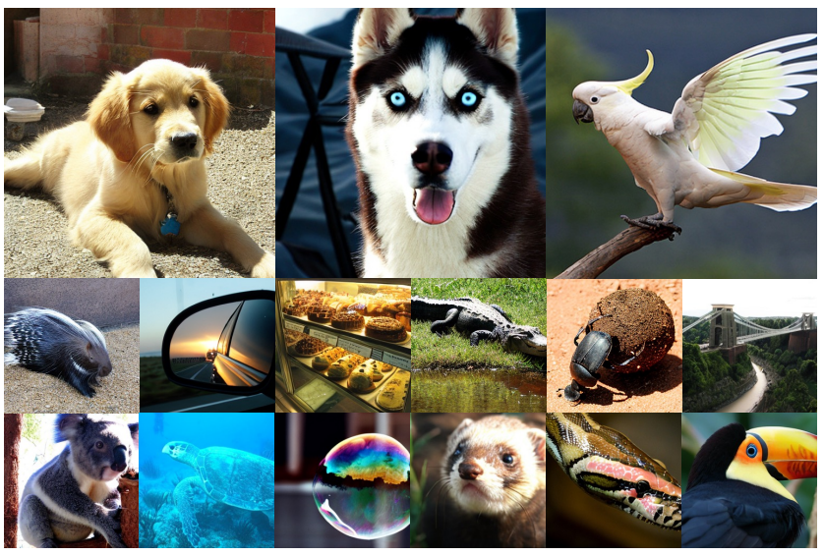
Recap: Diffusion in Vision
1. From Vision to Language
These models rely on continuous corruption and denoising in a fixed-dimensional space.
Latent Diffusion
DiT
R. Rombach et al., “High Resolution Image Synthesis with Latent Diffusion Models”, CVPR 2022.
Peebles & Xie., “Scalable Diffusion Models with Transformers”, CVPR 2023.

Slide 6
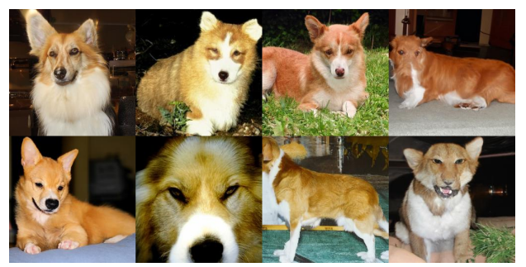
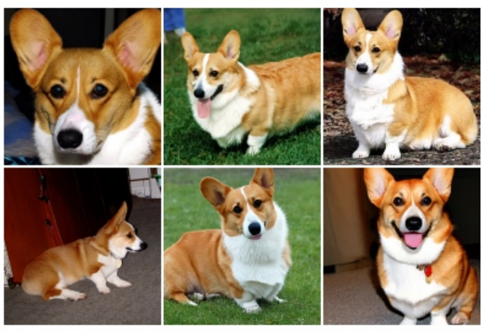
Recap: Diffusion in Vision
1. From Vision to Language
These models rely on continuous corruption and denoising in a fixed-dimensional space.
Classifier Guidance
Classifier-Free Guidance
Dhariwal et al. ”Diffusion Models Beat GANs on Image Synthesis” , NeurIPS 2021
Ho & Salimans., “CLASSIFIER-FREE DIFFUSION GUIDANCE”, NeurIPS 2021.

Slide 7
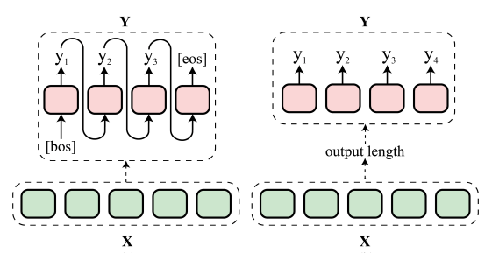
Bringing Diffusion to Language
1. From Vision to Language
Diffusion models work well in the vision domain.
Then, can we apply the diffusion process to language generation?
First, since humans typically speak sequentially, it seems natural to model language generation as a sequential process
Then, why look beyond sequential generation and explore a parallel, iterative framework like diffusion?
Su et al., “Non-Autoregressive Text Generation with Pre-trained Language Models”, EACL 2021.

Slide 8
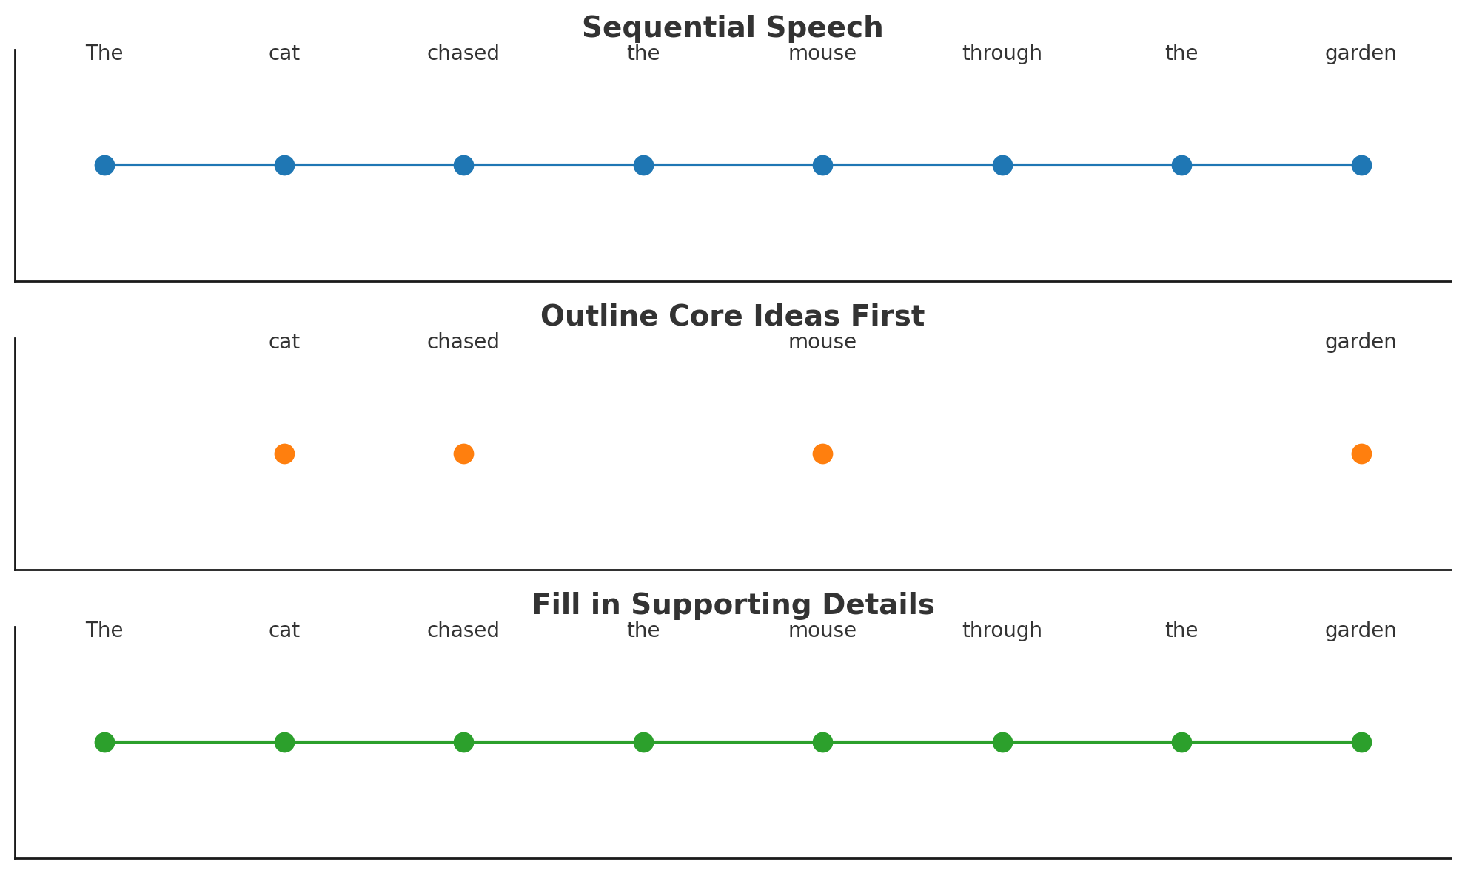
Simple Rationale for Using Diffusion in Text
1. From Vision to Language
While humans speak sequentially, we do not always produce a full sequence strictly from start to end.
We sometimes outline key ideas or core words first, then fill in supporting details and refine the structure.

Slide 9
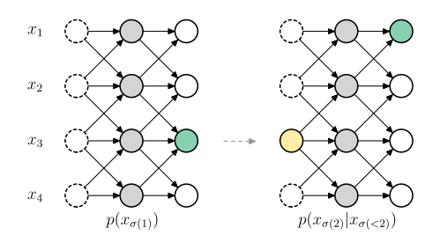
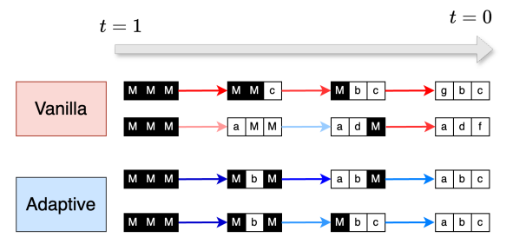
Diffusion as the generalization of AR-based approach
1. From Vision to Language
Recent observations show that left-to-right decoding can be interpreted as a specific, degenerate case of diffusion modeling with a fixed generation order.
A flexible generation order allows the model to leverage bidirectional context, avoid early-error lock-in, and adapt generation strategy to the task.
Autoregressive Diffusion Models
(Hoogeboom et al., 2022)
Understanding Token Ordering in Masked Diffusions (Kim et al., 2025)
Hoogeboom et al., “Autoregressive Diffusion Models”, ICLR, 2022.
Kim et al., “Train for the Worst, Plan for the Best: Understanding Token Ordering in Masked Diffusions”, ICML, 2025.

Slide 10
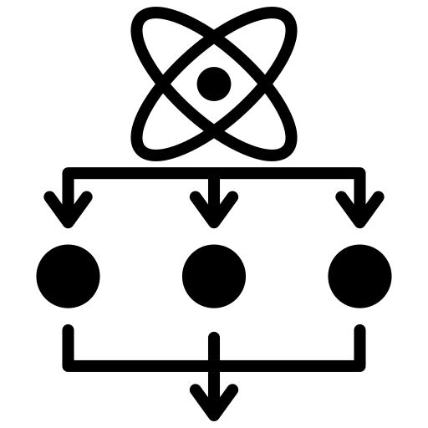



Why Use Diffusion Language Models?
1. From Vision to Language
Autoregressive (AR) models still perform well.
So why should we consider using diffusion for language models?
Parallel Decoding
Controllability
Iterative Refinement
Bidirectional Context
All tokens can be generated simultaneously, utilizing more hardware
Generation could be easily steered with Classifier guidance, Classifier-free guidance
Allows correction of early mistakes and globally coherent outputs
Considers full sequence context during denoising, enabling infilling

Slide 11
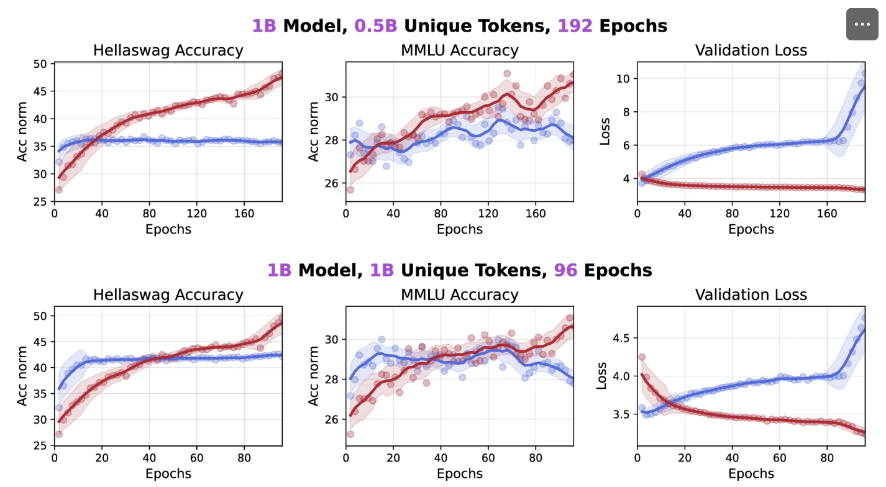
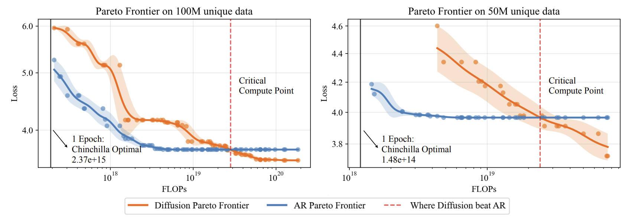

Why Use Diffusion Language Models?
1. From Vision to Language
Better in Data-Constrained Settings: When data is scarce but compute is abundant, diffusion models can outperform autoregressive (AR) models.
Ni et al., “Diffusion Language Models are Super Data Learners”, 2025.

Slide 12
The Challenge: Discreteness of Text

Slide 13
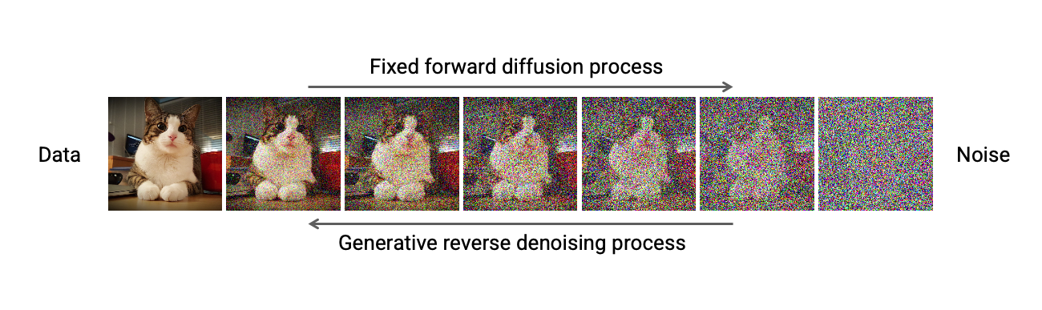
Why Diffusion Doesn’t Directly Work on Text
2. Discreteness of Text
For image, when noised, still a valid image at each step
https://cvpr2022-tutorial-diffusion-models.github.io/

Slide 14
Why Diffusion Doesn’t Directly Work on Text
2. Discreteness of Text
Unlike images, text is made of discrete tokens
-> we can’t smoothly add noise like we do with pixels.
For text tokens
Text | Tokens
The cat sits on the mat | 0, 40, 43, 13, 2, 67
? ? ? ? ? ? | 0.5, 40.71, 42.1, 13.4, 1.8, 66.4
Rounding?
No image why on the love | 1, 41, 42, 13, 2, 66

Slide 15
Fragility of Semantics
2. Discreteness of Text
In images, a small perturbation in a single pixel (e.g., brown → red) is less noticeable and rarely changes the overall meaning.
In text, even a single token change (e.g., “a” → “b” or “cat” → “car”) can completely alter meaning and grammaticality.
“My cat ate a fish”
→ “My car ate b fish”
Thus, it’s harder for diffusion in text to ensure that noisy intermediate states map back to fluent, coherent sentences.

Slide 16
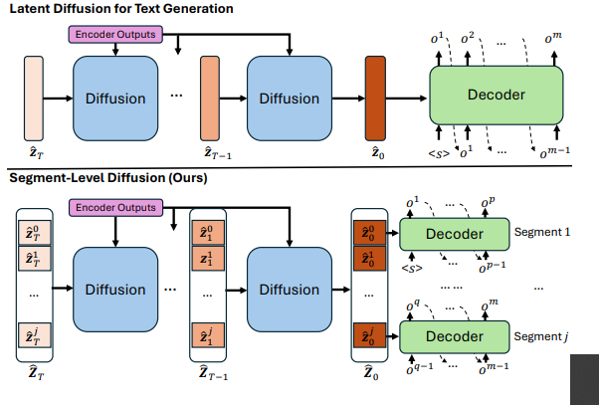
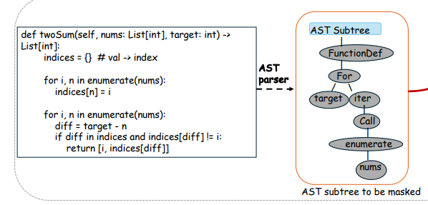
Breaking Token-Level Coherence
2. Discreteness of Text
Token-level corruption in diffusion assumes conditional independence between positions at each denoising step.
This can break sequential dependencies (syntax, semantics, ordering), especially in structured or long-form text.
Segment-Level Diffusion
(Zhu et al., 2025)
TreeDiff
(Ren et al., 2025)
Zhu et al., “Segment-Level Diffusion”, ACL, 2025.
Ren et al., “TreeDiff: AST-Guided Code Generation with Diffusion LLMs”, 2025.

Slide 17
Two Big Families of DLMs

Slide 18
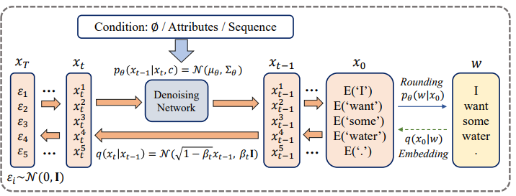
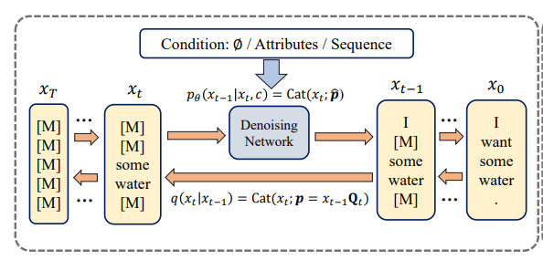
Dealing with Discreteness
3. Two Big Families of DLMs
To apply diffusion to language, we need to bridge the gap between discrete tokens and the continuous noise-based diffusion framework.
Two main paradigms
Continuous Diffusion
Discrete Diffusion
https://www.ijcai.org/proceedings/2023/0750.pdf

Slide 19
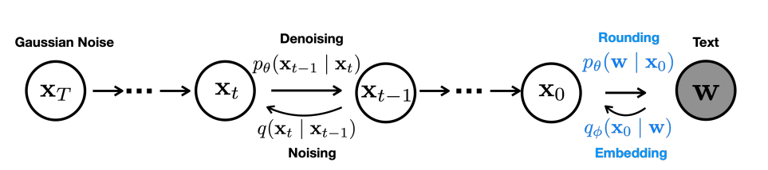
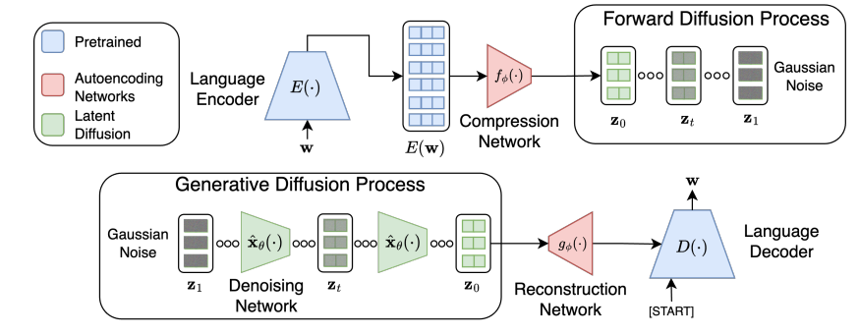
Continuous Diffusion Language Model
3. Two Big Families of DLMs
Instead of adding noise directly to tokens, we embed tokens into a continuous space and apply diffusion there.
Embedding space
(Diffusion-LM, 2022)
Latent space
(LD4LG, 2022)
Diffusion-LM (2022), LD4LG (2022), Genie (2023), AR-Diffusion (2024)…
https://arxiv.org/abs/2205.14217
https://arxiv.org/pdf/2212.09462

Slide 20
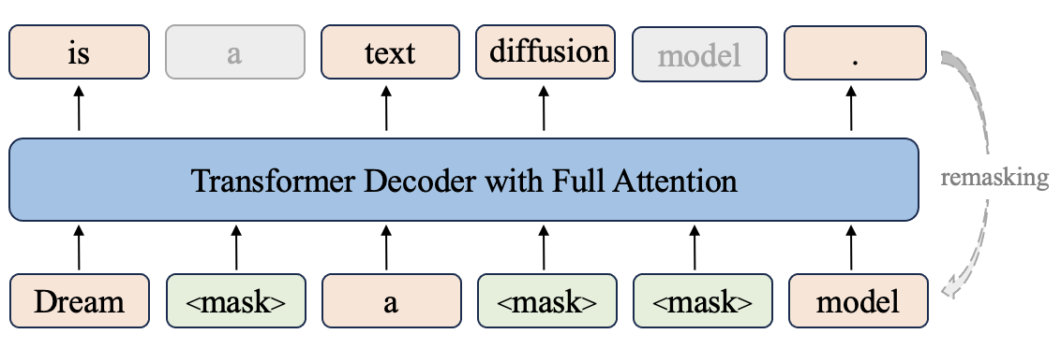
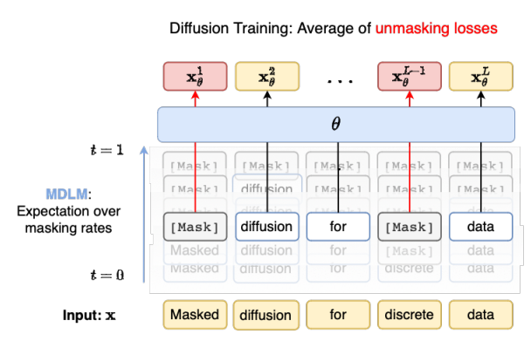
Discrete Diffusion Language Model
3. Two Big Families of DLMs
Instead of embedding tokens into a continuous space, discrete diffusion models operate directly in token space by progressively corrupting the input sequence through symbolic operations.
Random replace, mask or shuffle
Dream
(Ye et al., 2025)
MDLM
(Sahoo et al., 2024)
DiffusionBERT (2022), MDLM (2024), SEDD (2024), LLADA (2025)…
https://hkunlp.github.io/blog/2025/dream/
https://arxiv.org/pdf/2406.07524

Slide 21
Continuous VS. Discrete Diffusion
3. Two Big Families of DLMs
Continuous Diffusion LM
Discrete Diffusion LM
Space
Embedding, Latent
Token
Noising process
Continuous noising
Masking, Replacing
Faster single-step operations (low-dim)
Classifier guidance
Image-based techniques are applicable
Works directly on tokens
Easier alignment with existing models
Simplified training objective
Pros
Training instability
Scaling to large corpora remains unproven
Requires encoder/decoder modules
Classifier guidance is limited
Transition itself is not differentiable
Cons

Slide 22
Continuous Diffusion
Language Models

Slide 23
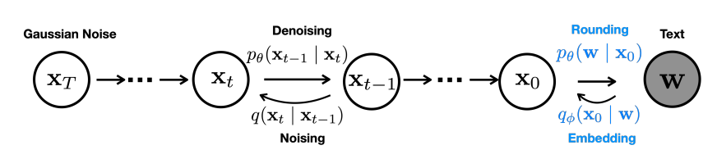
Diffusion-LM
4. Continuous Diffusion Language Models
Diffusion-LM introduces embedding and rounding steps to map discrete tokens into a continuous domain suitable for diffusion.
Forward pass: $q\left(x_{t} | x_{t−1}\right)=N({x_{t}; \sqrt{1−β_{t}}x}_{t−1}, β_{t}I)$
Same as in DDPM
Backward pass:
$${ p}_{θ}\left(x_{t−1} | x_{t}\right)=N({x_{t−1}; μ}_{θ}(x_{t},t), {σ_{t}}^{2}I)$$
Li et al., “Diffusion-LM Improves Controllable Text Generation”, NeurIPS, 2022.

Slide 24


Diffusion-LM
4. Continuous Diffusion Language Models
Objective function
DDPM objective
Embedding & Rounding
added
Predict $x_{0}$ instead
Li et al., “Diffusion-LM Improves Controllable Text Generation”, NeurIPS, 2022.

Slide 25
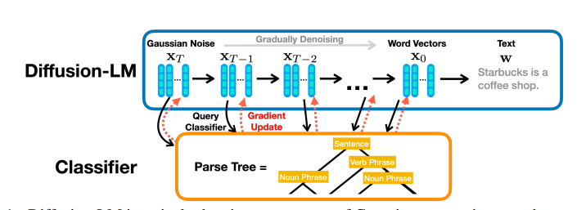


Diffusion-LM
4. Continuous Diffusion Language Models
Classifier-guidance
$$p\left(x_{0:T}|c\right)= \prod_{t=1}^{T}{p(x_{t−1}|x_{t}, c)}$$
By Bayes rule,
$p\left(x_{t−1} | x_{t},c\right)∝$ $p\left(x_{t−1} | x_{t}\right)p\left(c | x_{t−1},x_{t}\right)$
Conditional independence
$$p\left(c | x_{t−1},x_{t}\right)=p\left(c | x_{t−1}\right)$$
$$∇\log{p\left(x_{t−1} | x_{t},c\right)}=∇\log{p\left(x_{t−1} | x_{t}\right)}+∇\log{p\left(c | x_{t−1} \right)}$$
Li et al., “Diffusion-LM Improves Controllable Text Generation”, NeurIPS, 2022.

Slide 26
Diffusion-LM
4. Continuous Diffusion Language Models
MBR decoding
- Diffusion generated samples might contain misaligned/non-fluent sentences
-> Generate many candidates and then select the best
Sample 1
Model
Sample 2
-BLEU
Sample 2
Sample 3
Sample 4
- One of the commonly used decoding methods to compensate for low-quality generation in DLMs
Li et al., “Diffusion-LM Improves Controllable Text Generation”, NeurIPS, 2022.

Slide 27
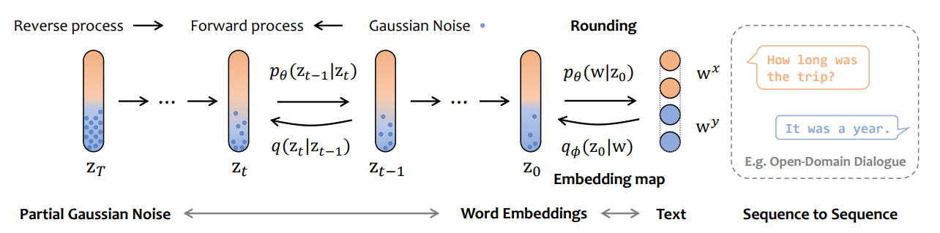
DiffuSeq
4. Continuous Diffusion Language Models
Extension of Diffusion-LM → supports conditional (Seq2Seq) text generation.
Partial noising: Add Gaussian noise only to target embeddings during forward process.
Conditional denoising: Transformer denoiser recovers $y_{0}$​ while attending to $x_{0}$ at every step.
Gong et al., “DIFFUSEQ: SEQUENCE TO SEQUENCE TEXT GENERATION WITH DIFFUSION MODELS”, ICLR 2023.

Slide 28
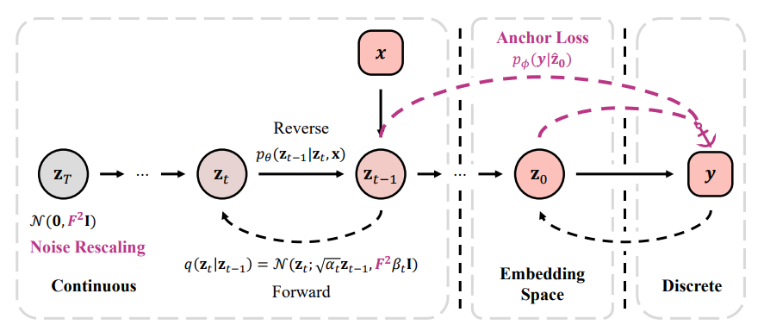
Difformer
4. Continuous Diffusion Language Models
Embedding Collapse: Learnable embeddings shift during training, leading to unstable training and reduced representation capacity
Denoising Model Degeneration: Insufficient noise in high-dimensional embedding space
Gao et al., “Empowering Diffusion Models on the Embedding Space for Text Generation”, NAACL 2024.

Slide 29
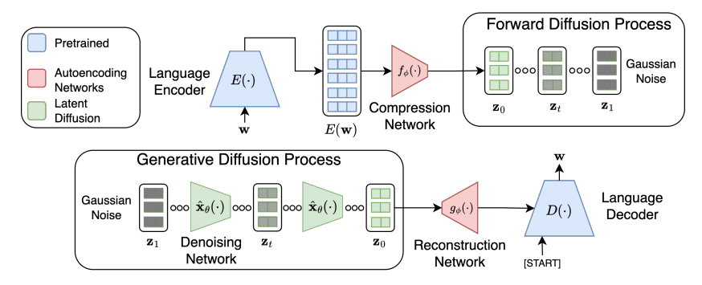
LD4LG
4. Continuous Diffusion Language Models
Instead of utilizing trainable embedding, use encoder-decoder for latent diffusion
Use a pretrained encoder–decoder LM (BART/T5) to build a language autoencoder.
Compress encoder outputs into a fixed-length, continuous latent space → run diffusion here → reconstruct text via pretrained decoder.
Lovelace et al., “Latent Diffusion for Language Generation, NeurIPS 2023.

Slide 30
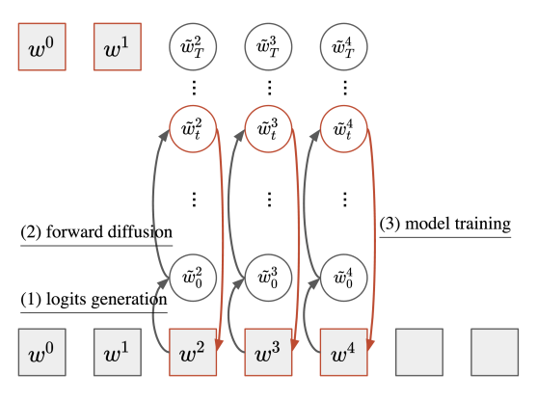
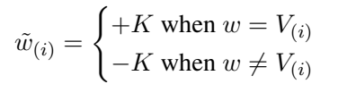
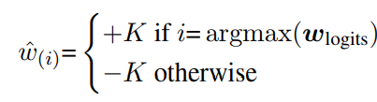
SSD-LM
4. Continuous Diffusion Language Models
Inherent limitation in diffusion LMs -> Fixed length generation
Instability in embedding based formulation (+ classifier incompatibility)
Propose semi-autoregressive decoding
(parallel generation within each block, autoregressive generation across blocks)
Operate directly in vocabulary space
(no embedding, latent mapping)
Han et al., “SSD-LM:Semi-Autoregressive Simplex-based Diffusion LM”, ACL 2023.

Slide 31
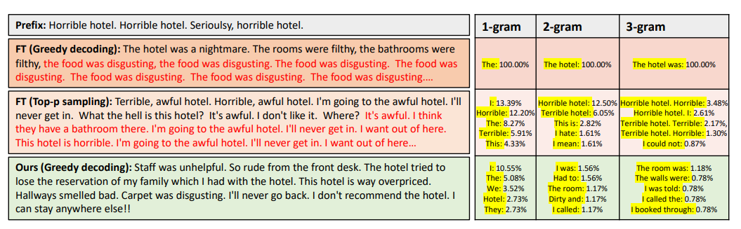
Downstream Applications
4. Continuous Diffusion Language Models
Easy to integrate attribute control (e.g., sentiment, style, topic) using external or learned classifiers.
Stochastic, multi-step sampling naturally explores multiple plausible outputs.
Controllable generation, Textual style transfer, Artistic generation
Zhang et al., “PLANNER: Generating Diversified Paragraph via Latent Language Diffusion Model”, NeurIPS 2023.

Slide 32
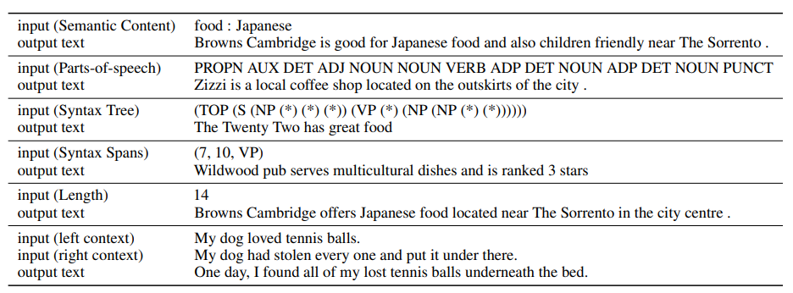
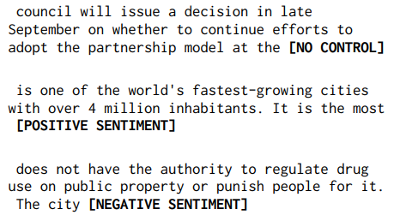
Downstream Applications
4. Continuous Diffusion Language Models
Controllable Text Generation
Diffusion-LM (Li et al., 2022)
SSD-LM (Han et al., 2022)
Li et al., “Diffusion-LM Improves Controllable Text Generation”, NeurIPS, 2022.
Han et al., “SSD-LM:Semi-Autoregressive Simplex-based Diffusion LM”, ACL 2023.

Slide 33
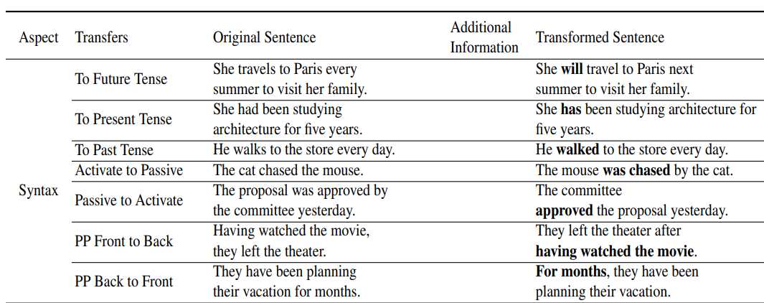
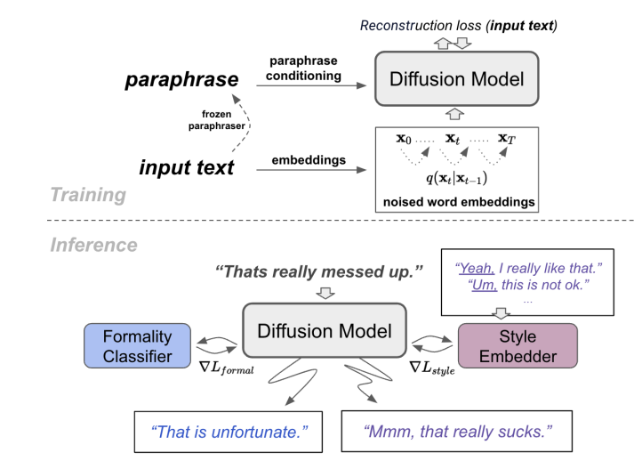
Downstream Applications
4. Continuous Diffusion Language Models
Text style transfer
Diffuseq-StylePTB (Lyu et al., 2023)
ParaGuide
(Horvitz et al., 2024)
Lyu et al., “Fine-grained Text Style Transfer with Diffusion-Based Language Models”, RepL4NLP 2023.
Horvitz et al., “ParaGuide: Guided Diffusion Paraphrasers for Plug-and-Play Textual Style Transfer”, AAAI 2024.

Slide 34
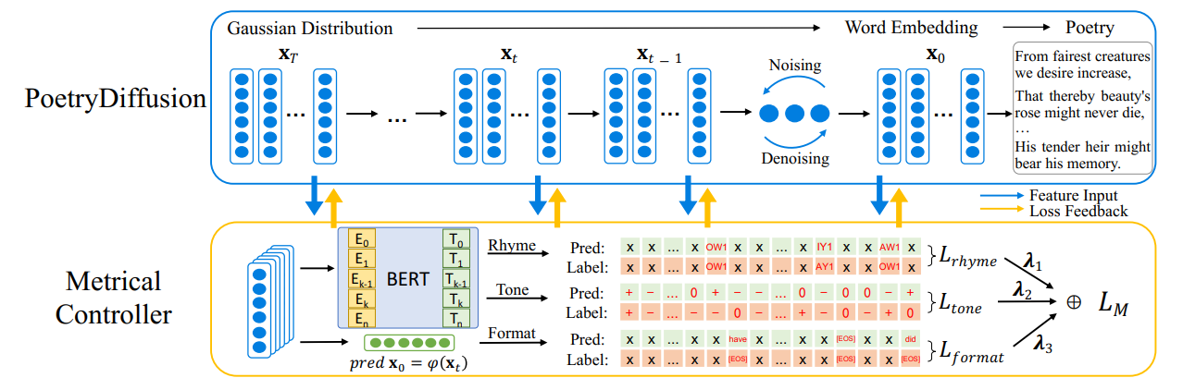
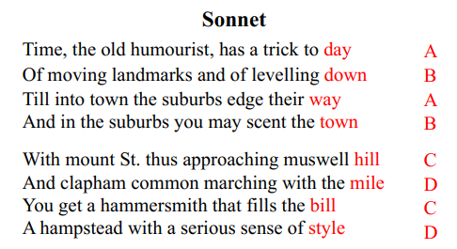
Downstream Applications
4. Continuous Diffusion Language Models
Dialog/Poetry generation
PoetryDiffusion (Hu et al., 2024)
Hu et al., “PoetryDiffusion: Towards Joint Semantic and Metrical Manipulation in Poetry Generation”, AAAI 2024.

Slide 35
Next week
Week 8
Diffusion Language
Models Ⅱ
Discrete diffusion language models
Masking & Absorbing state
Token ordering
Week 8
Diffusion Language
Models Ⅲ
AR VS. NAR
AR-like formulation in DLMs
Block-wise diffusion

Slide 36


